Slide 1
Predicting ventricular arrhythmias from ECG wave measurements.
Alejandro Reyes
Supervised Learning Capstone
Thinkful Data Science Bootcamp

Slide 2
Motivation
Electrocardiography is one of the cornerstones of diagnosis in cardiology.
Many occasions where ambiguous ECGs lead to delayed and/or inadequate treatment while awaiting a second opinion/third opinion.
These diagnoses are based on experience and theory accumulated over many years of clinical studies. Evaluation of ECGs is largely visual.
Machine learning algorithms can bring something new to the table.

Slide 3
ECG Basics

Slide 4
Cardiac Conduction System:
Sinoatrial Node >
Atrium >
Atrioventricular Node >
Ventricles >
Repolarize >
(Repeat)

Slide 6
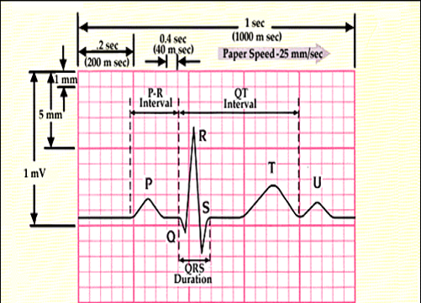

Slide 7
Approaches
Feature engineering based on concepts of ECG theory
Feature engineering based on machine learning theory

Slide 8
Data Exploration and Feature Engineering

Slide 9
Features
Total Features in raw data: 279
Patient Characteristics: Age, Sex, Height, Weight, Heart Rate (1-4, 15)
Wave and Interval Durations: 5 - 10
Wave Vector Angles: 10-14 (Dropped due to majority NaNs)
Duration, Deflections, Binary Indicators for wave characteristics (by lead): 16 - 159
Amplitude of waves (by lead): 160 - 279
Durations are measured in milliseconds, amplitudes are measured in millivolts according to ECG paper.
All continuous features were scaled after removing NaNs and outliers.
Notes:
Class code Class Number of instances
01 Normal 245
02 Ischemic changes (Coronary Artery Disease) 44
03 Old Anterior Myocardial Infarction 15
04 Old Inferior Myocardial Infarction 15
05 Sinus tachycardy 13
06 Sinus bradycardy 25
07 Ventricular Premature Contraction (PVC) 3
08 Supraventricular Premature Contraction 2
09 Left bundle branch block 9
10 Right bundle branch block 50
11 1. degree AtrioVentricular block 0
12 2. degree AV block 0
13 3. degree AV block 0
14 Left ventricule hypertrophy 4
15 Atrial Fibrillation or Flutter 5
16 Others 22

Slide 10
Binary Indicator for Presence of Arrhythmia
Choice made for binary indicator due to class imbalance original dataset had 14 classes:
One class which was non-ventricular
Multiple containing 1-10 data points combined all ventricular arrhythmias.
Normal ECG was the dominant class with 245 data points.
433 out of 492 Data points were used in the final model.

Slide 11
Mutual Features

Slide 12
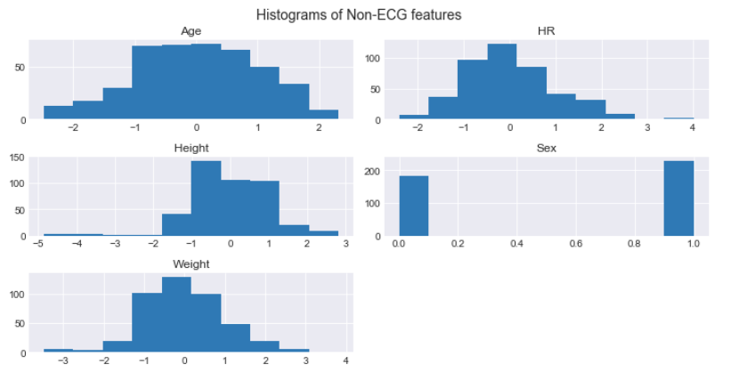
Patient Characteristics and HR

Slide 13
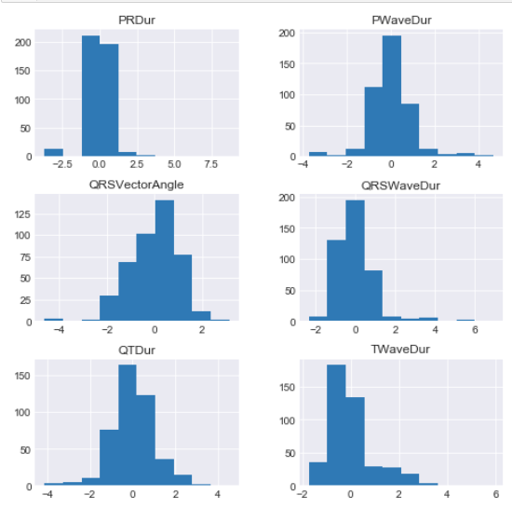
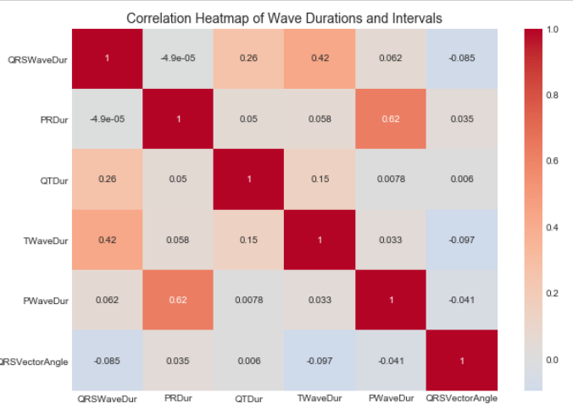
Wave and Interval Durations
Notes:
Multiple transformations were used to try to improve the distributions of these features but none really responded well to it. The correlation heatmap is

Slide 14
ECG Theory Approach

Slide 15
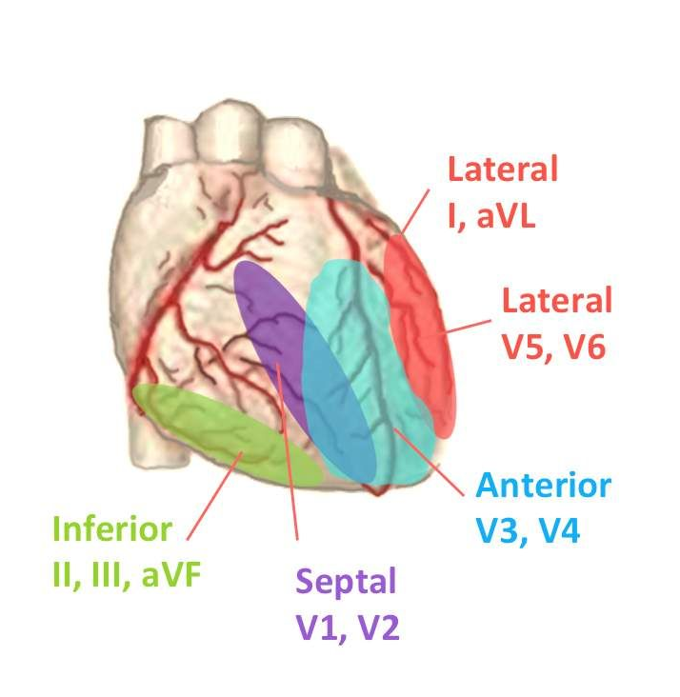

Slide 16
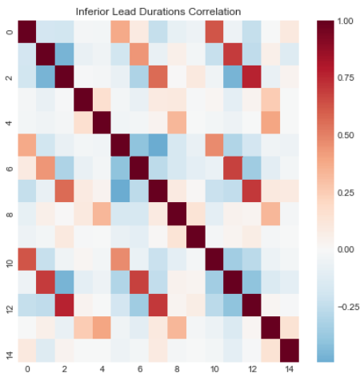
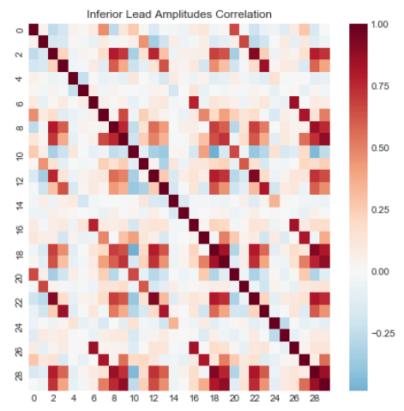
Inferior Leads Correlation

Slide 17
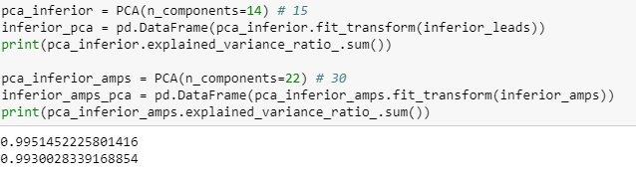

Slide 18
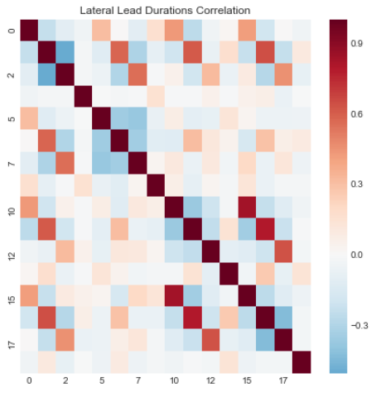
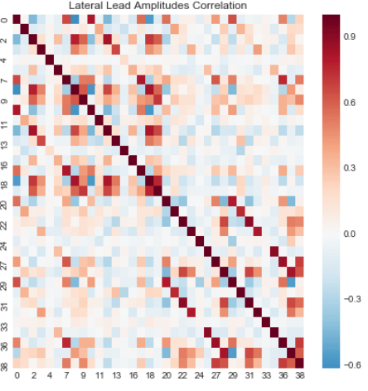
Lateral Leads Correlation

Slide 19
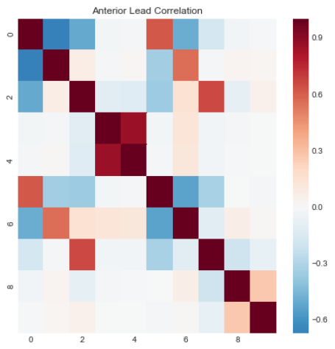
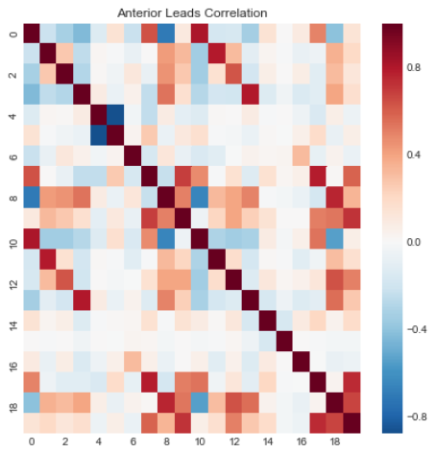
Anterior Leads Correlations

Slide 20
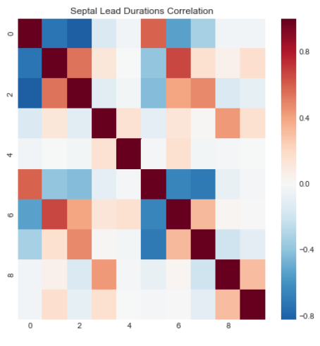
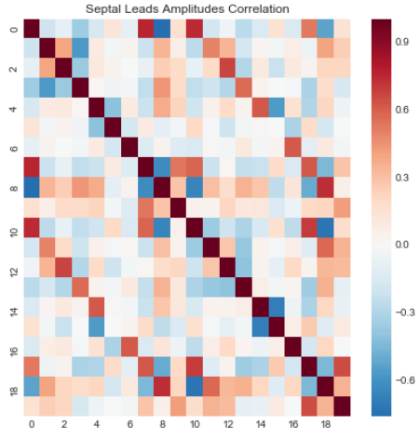
Septal Leads Correlation

Slide 21
Modelling Results

Slide 22
Evaluation Metric
10 Fold CV Accuracy
ROC Curve and AUC Score

Slide 23
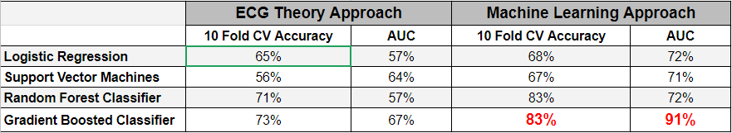
Best Model: ML Gradient Boosted Classifier

Slide 24
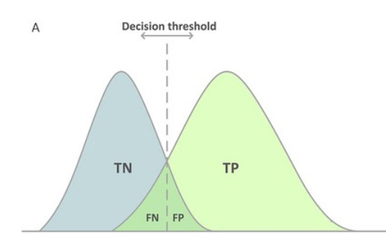
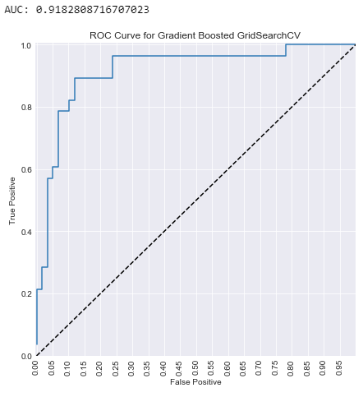
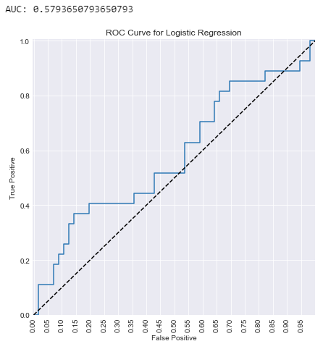

Slide 25
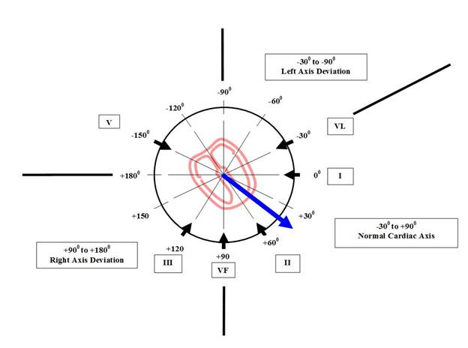
Feature Importances showed that the 11th feature (QRS Vector Angle) was 4 times more important than the second most important feature and 8 times more important than the third.

Slide 26
Conclusions and Comments
More data points.
Different form of data:
Raw ecg feeds
ECG Images
Possibly apply of unsupervised learning or timeseries analysis.
Diagnostic classifier vs. Binary Detection

